Slide 1
Section 4
Networking basics CIDR
Amazon VPC
VPC networking
VPC security (ACL/SG)
Dr Fatma Agery

Slide 2
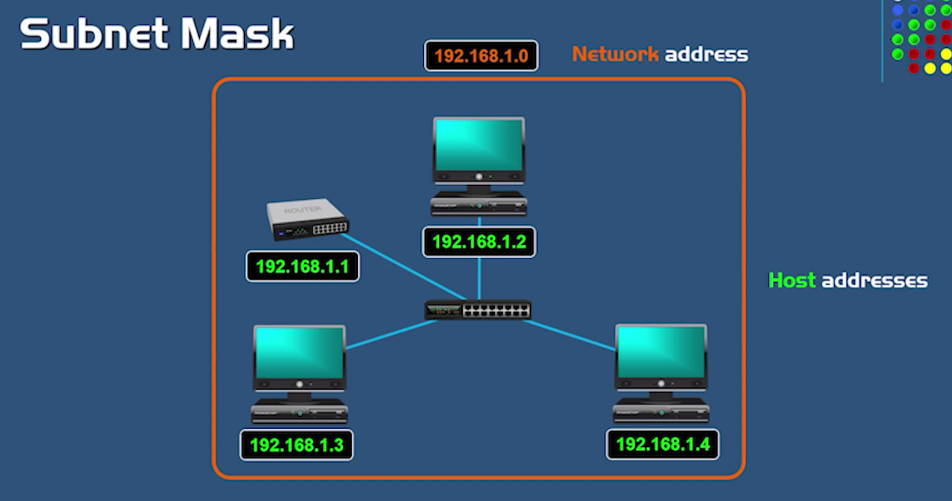

Slide 3
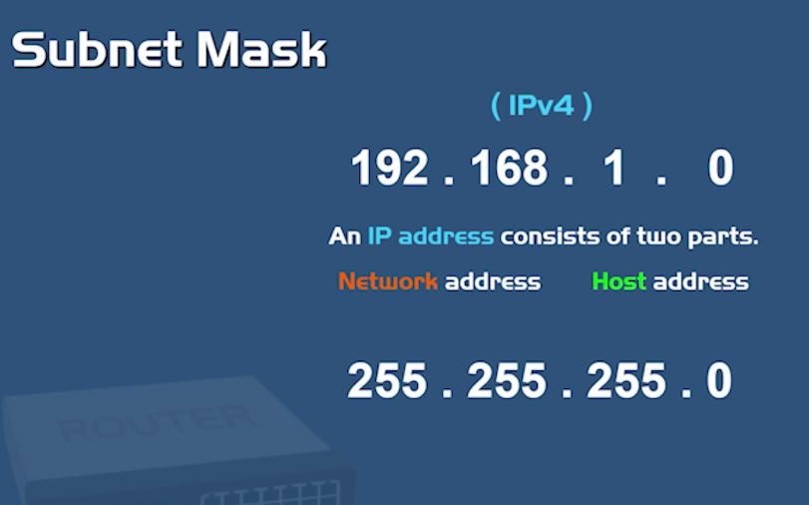

Slide 4
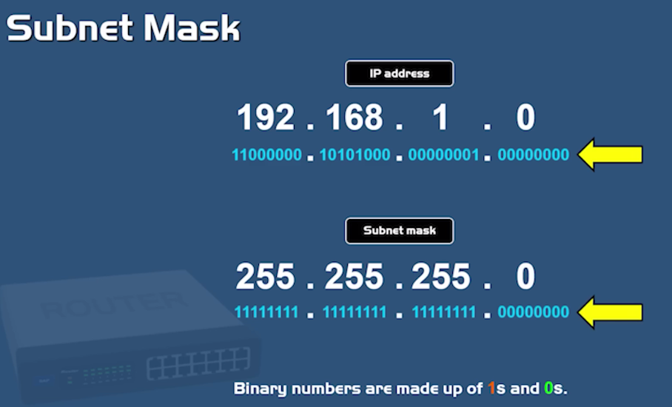

Slide 5
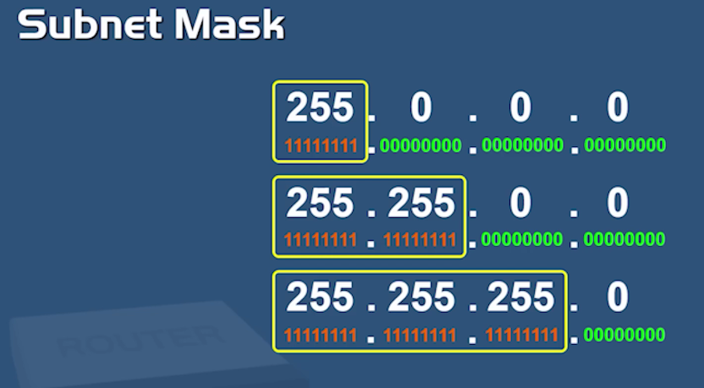

Slide 6
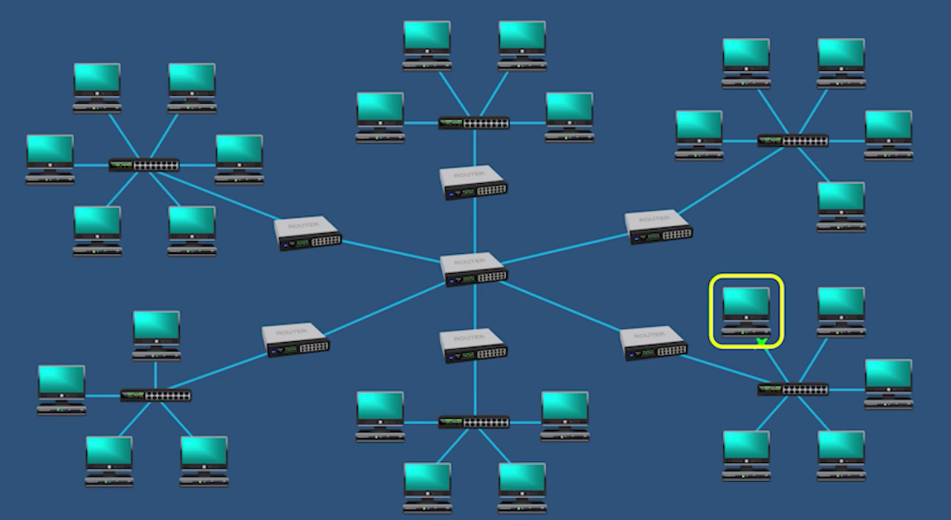

Slide 7
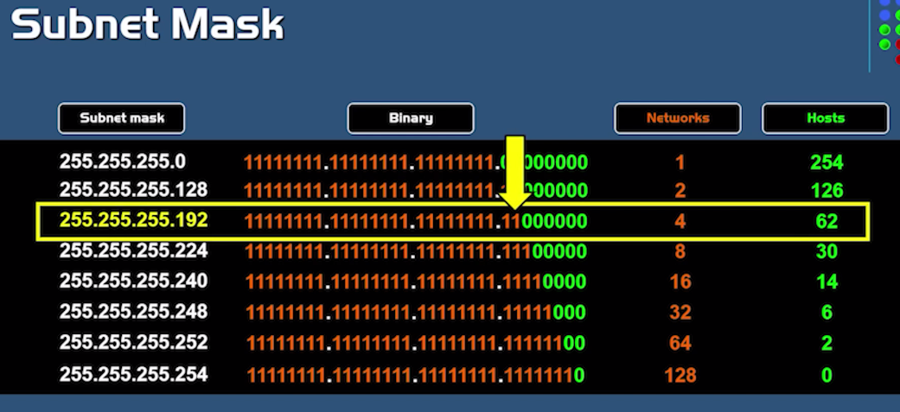

Slide 8
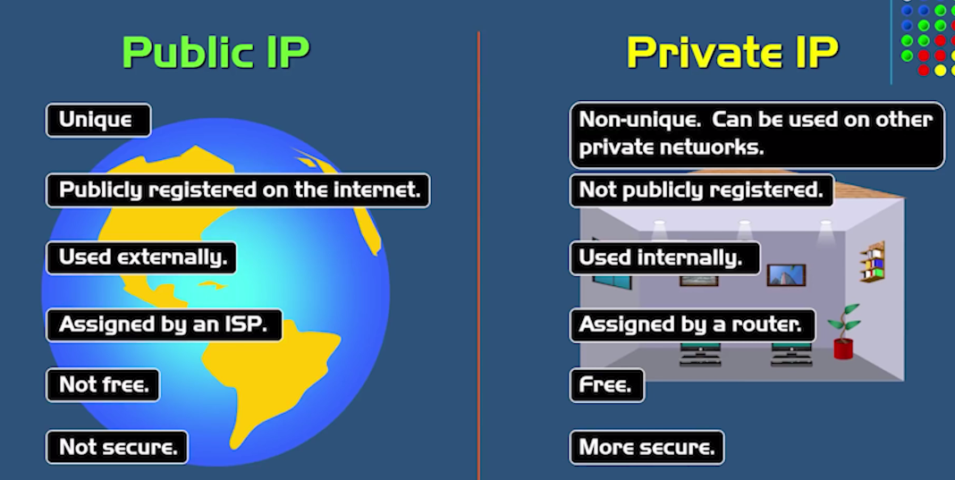

Slide 9
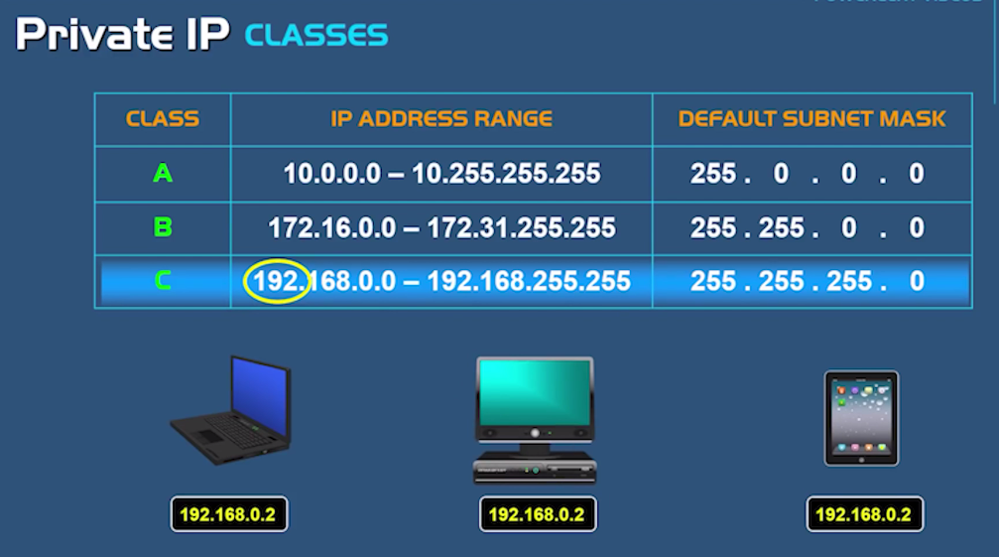

Slide 10
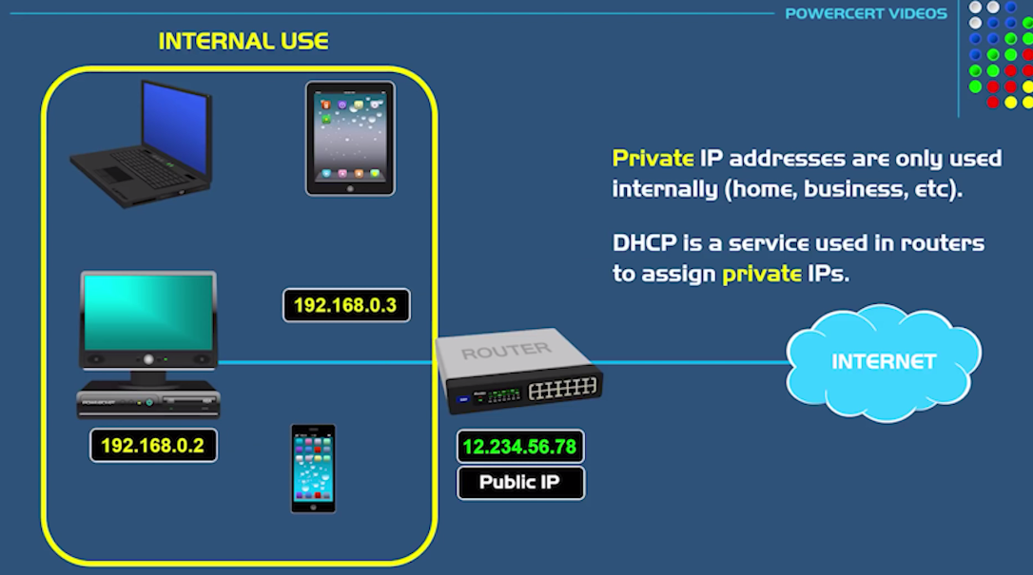

Slide 11
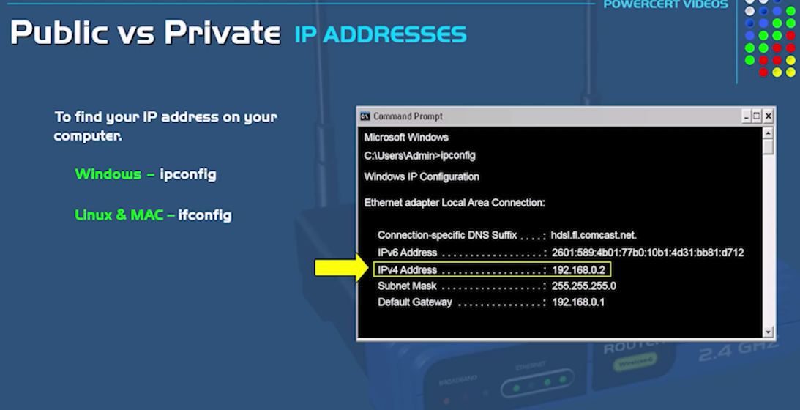

Slide 12
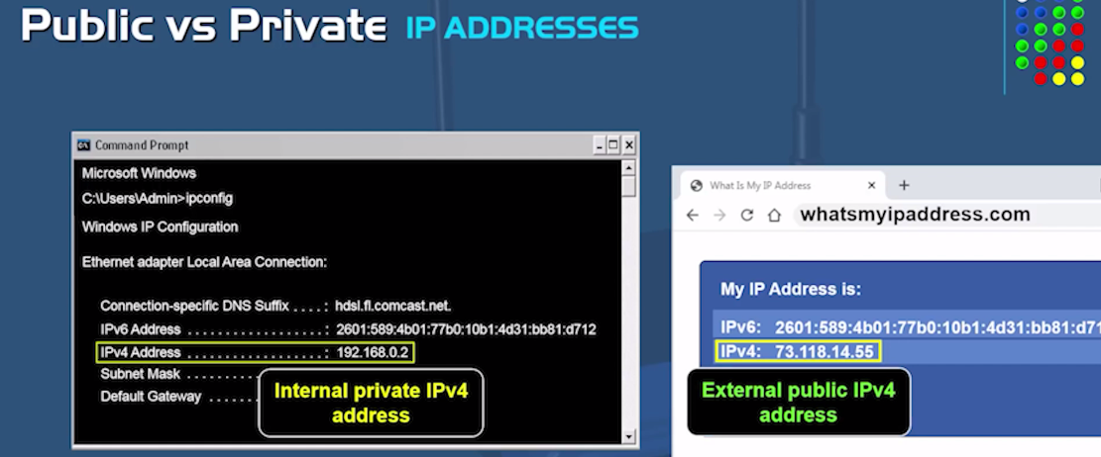

Slide 13
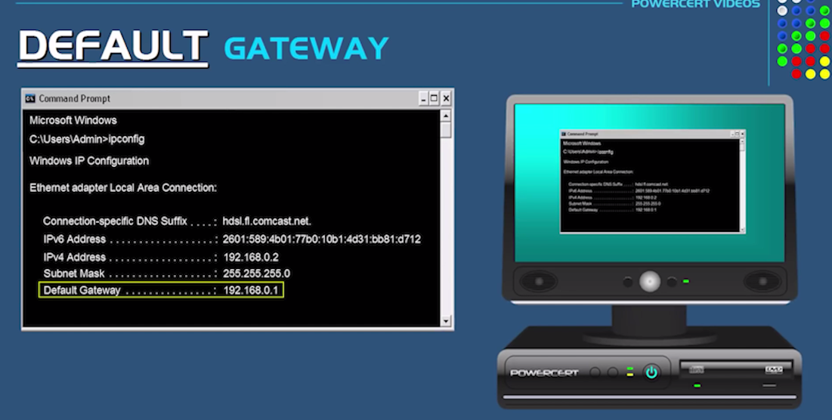

Slide 14
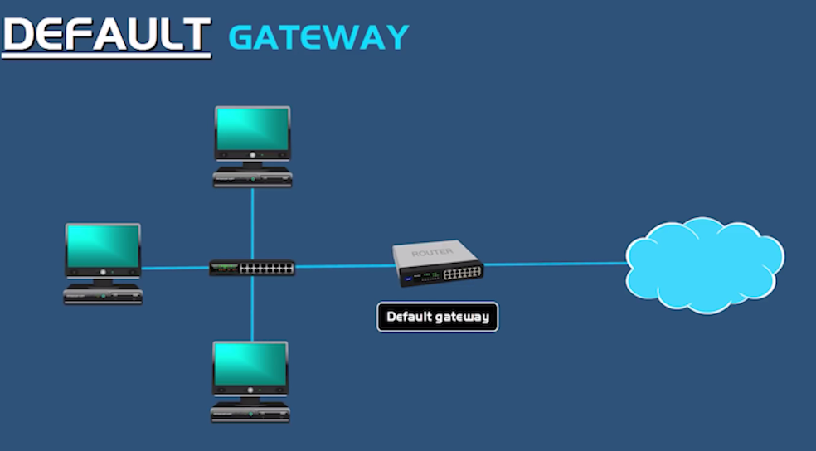

Slide 15
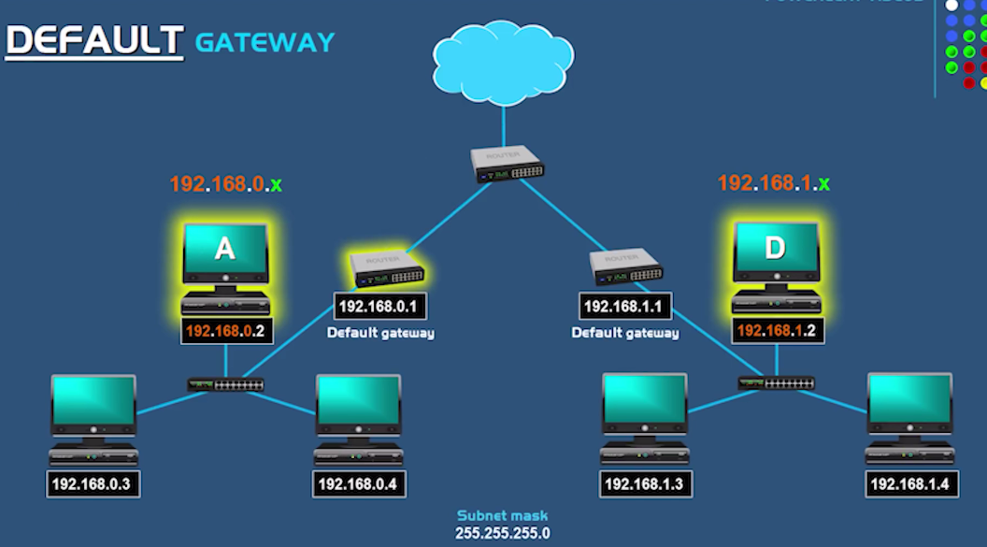

Slide 16
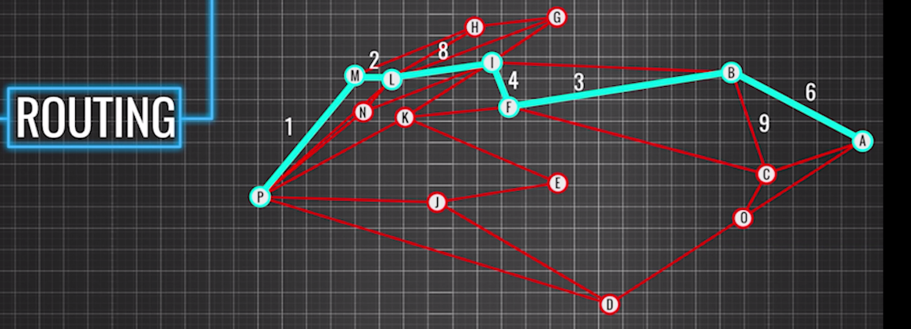

Slide 17
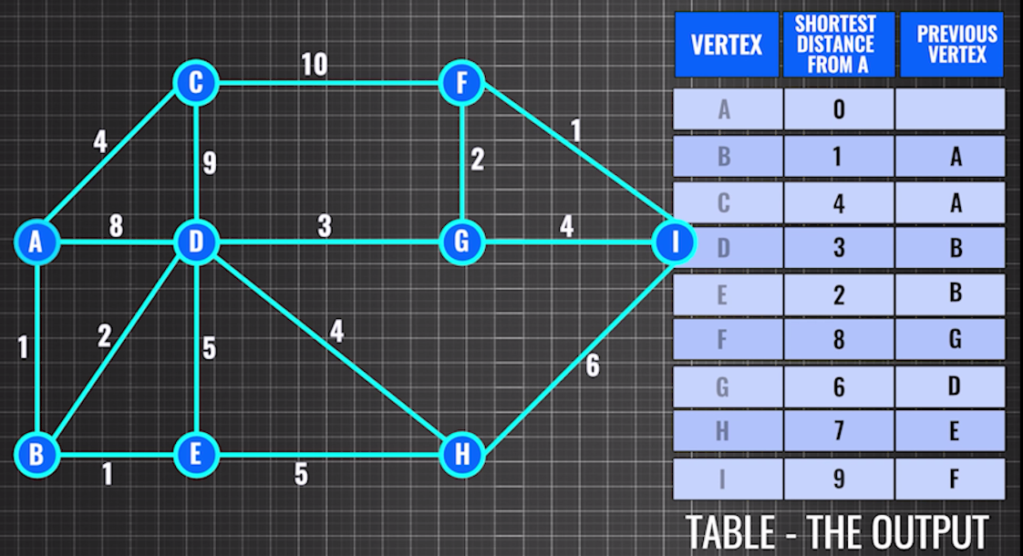

Slide 18
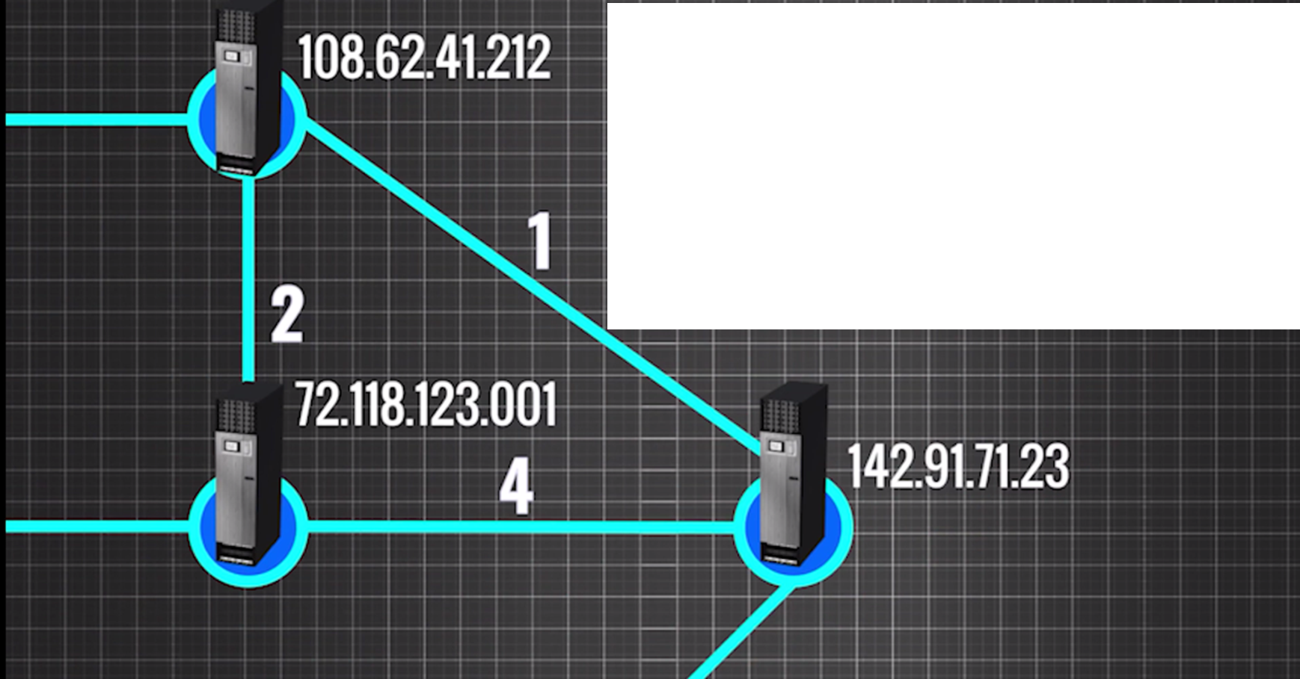

Slide 19
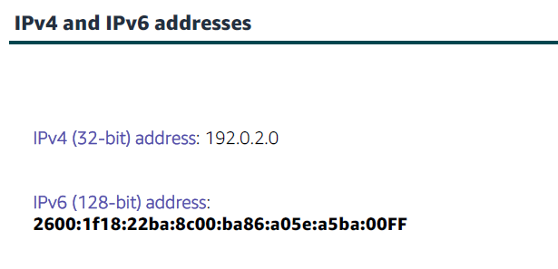

Slide 20
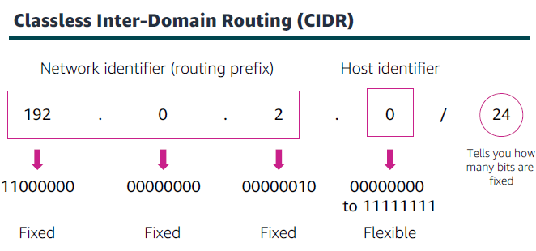

Slide 21
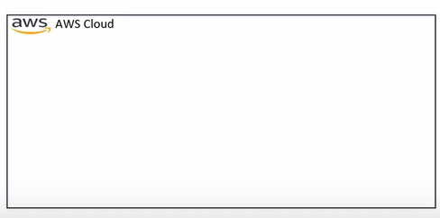
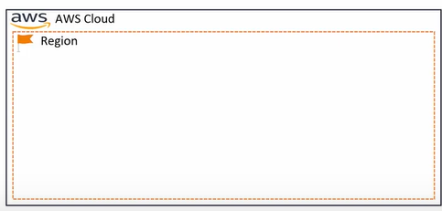

Slide 22
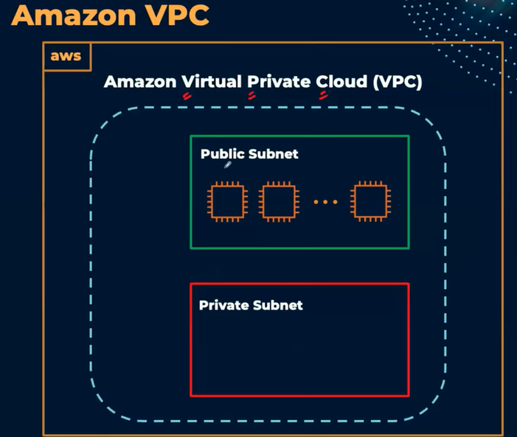

Slide 23
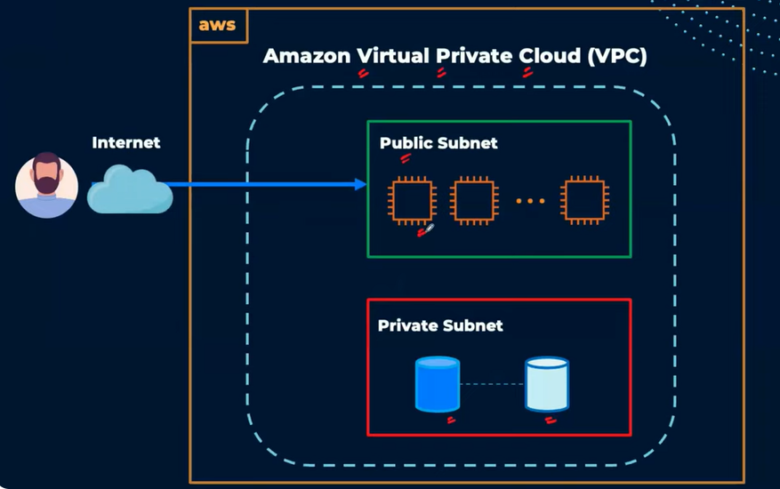

Slide 24
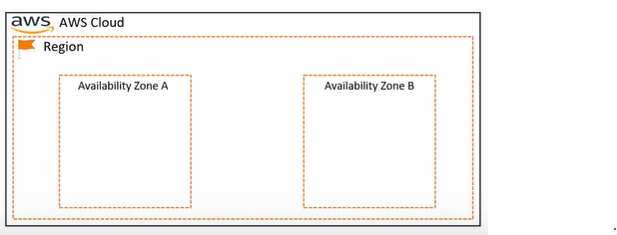
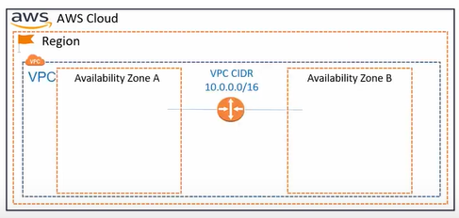

Slide 25
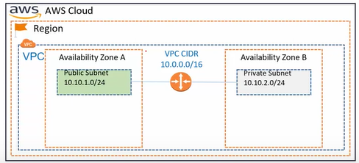

Slide 26
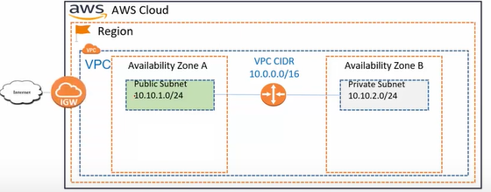

Slide 27
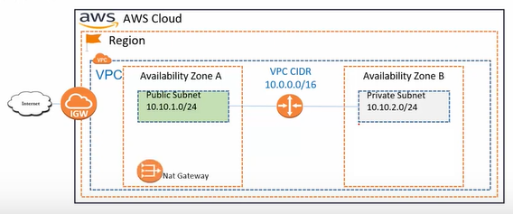

Slide 28
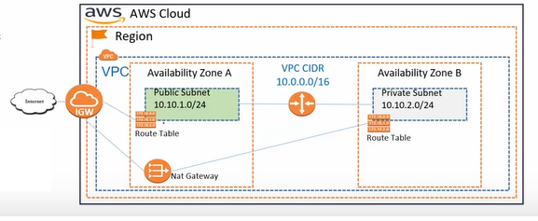

Slide 29
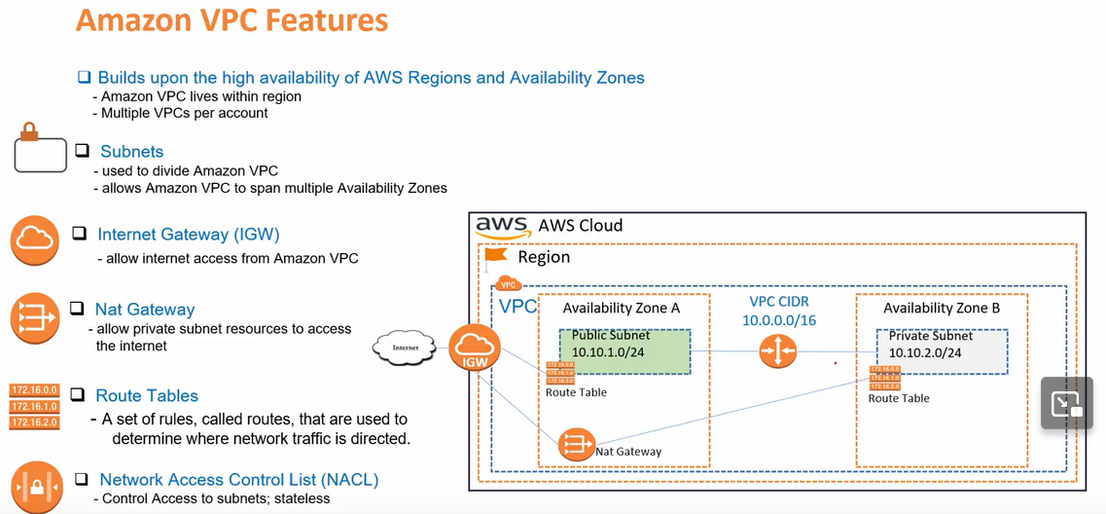

Slide 30
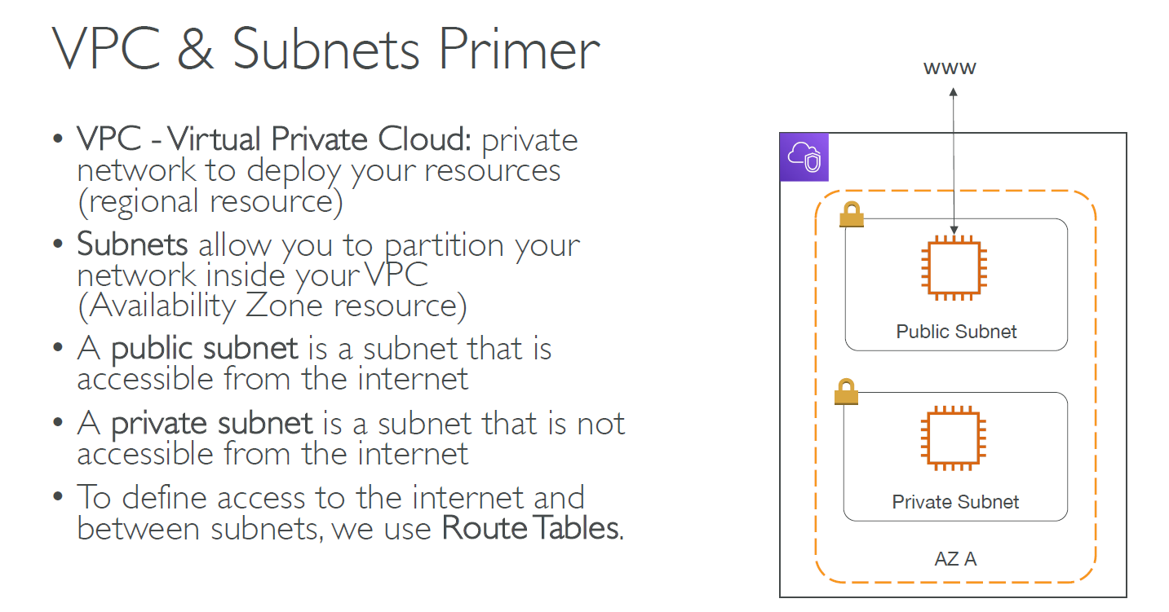

Slide 31
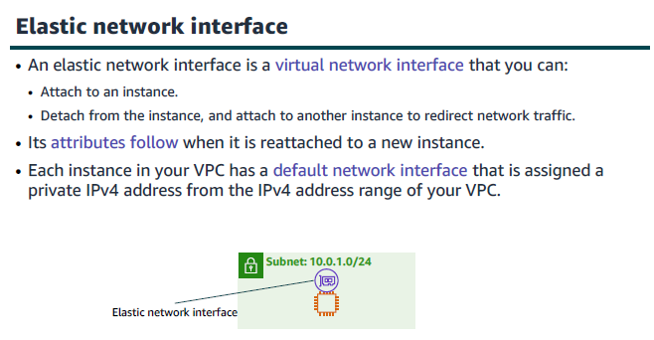

Slide 32
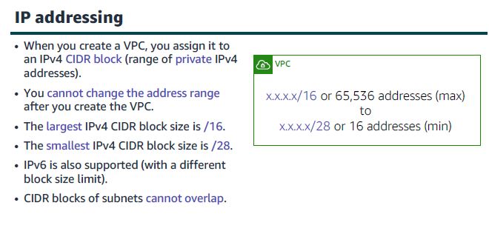
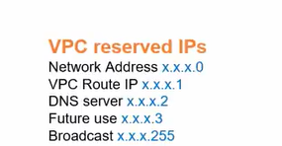

Slide 33
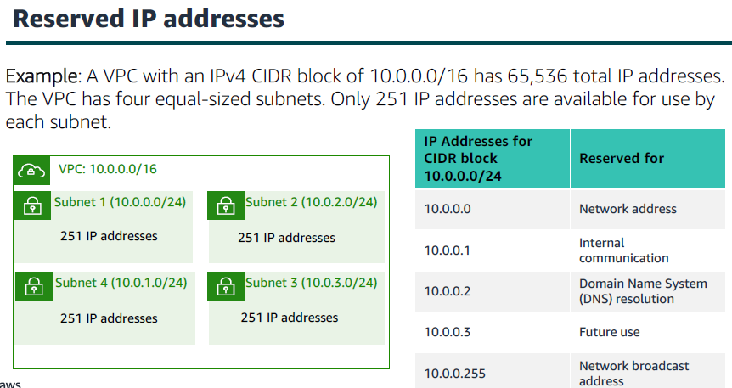

Slide 34
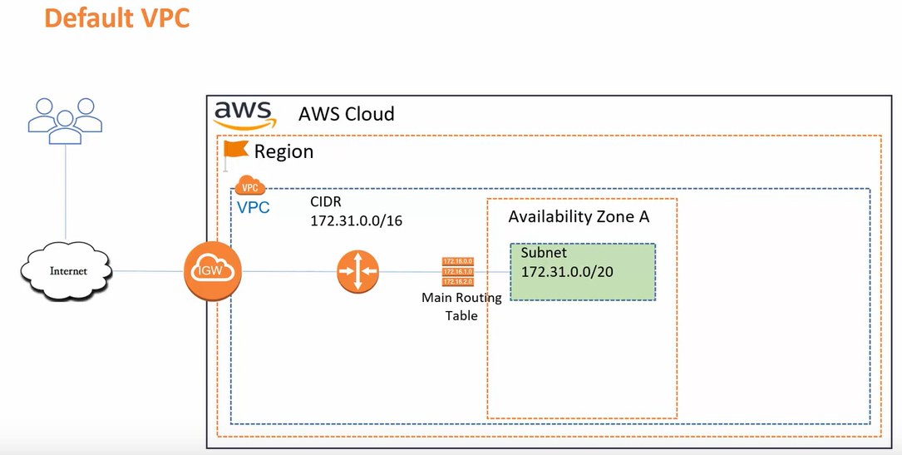

Slide 35
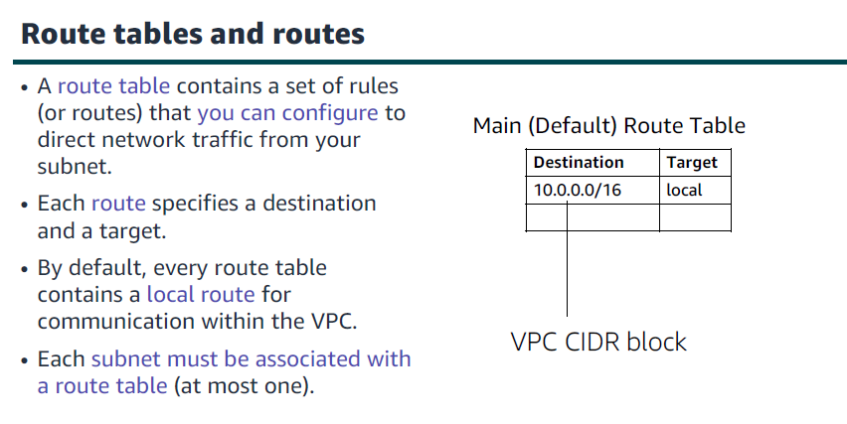

Slide 36
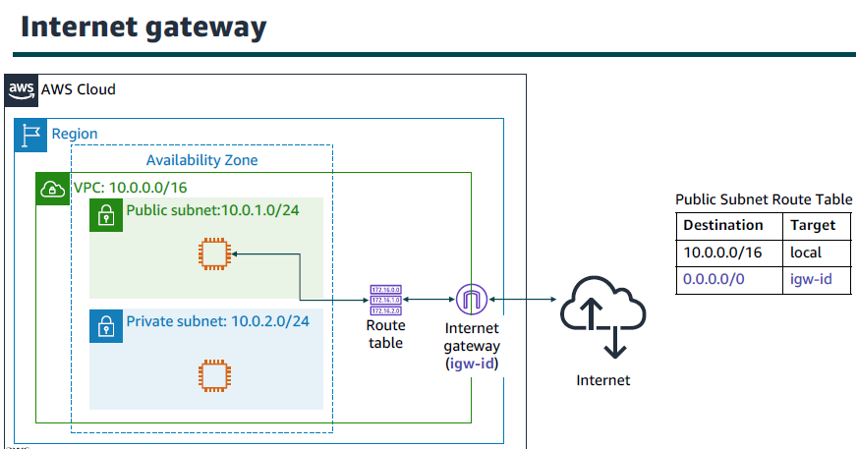

Slide 37
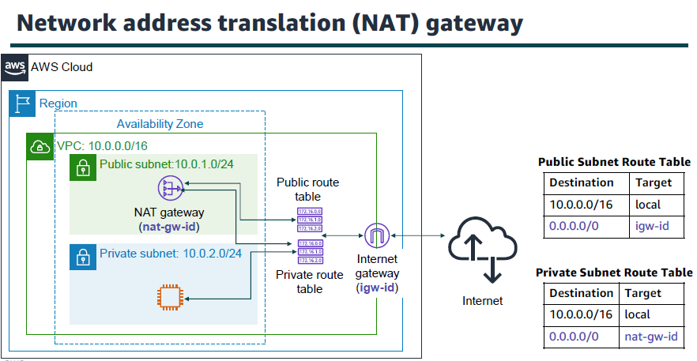

Slide 38
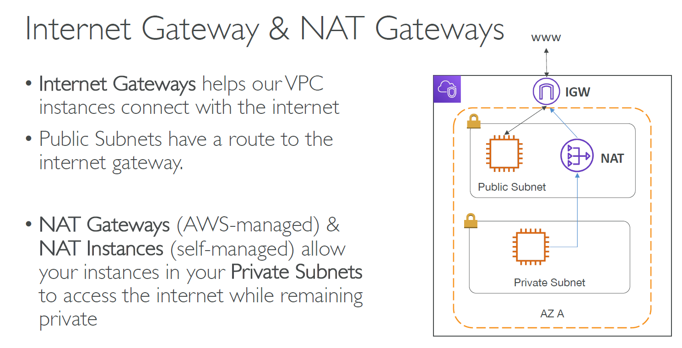

Slide 39
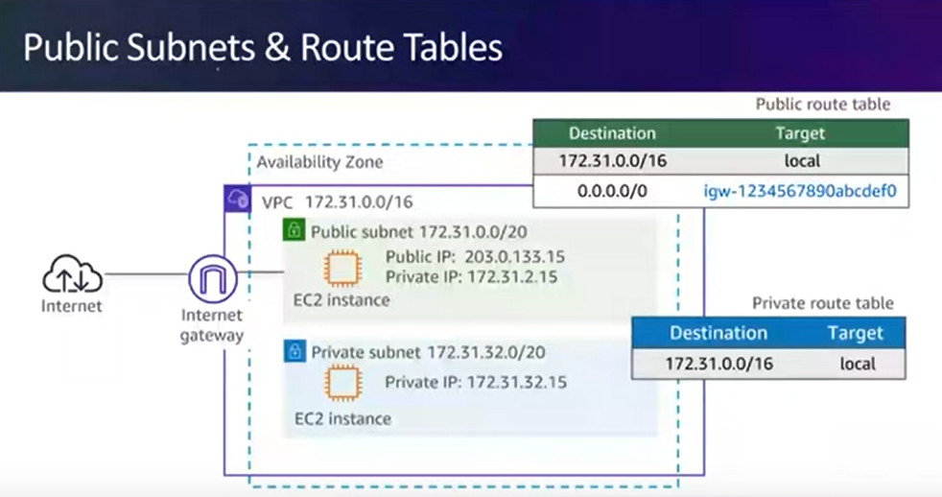

Slide 40
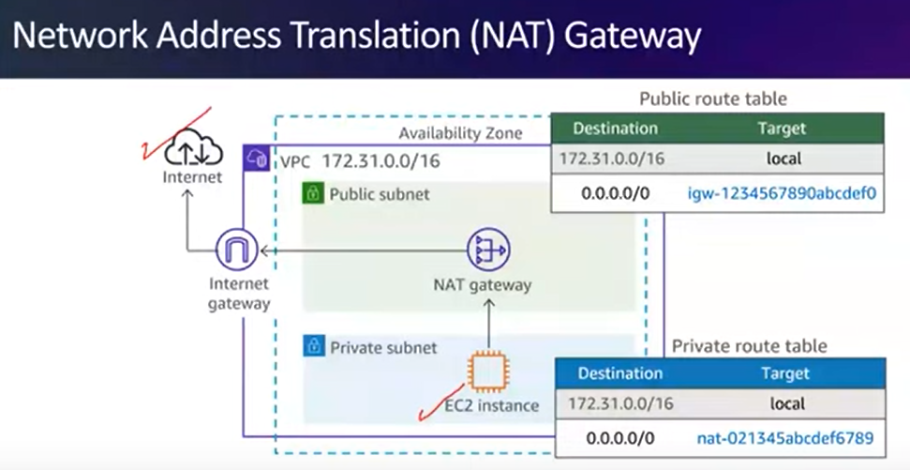

Slide 41
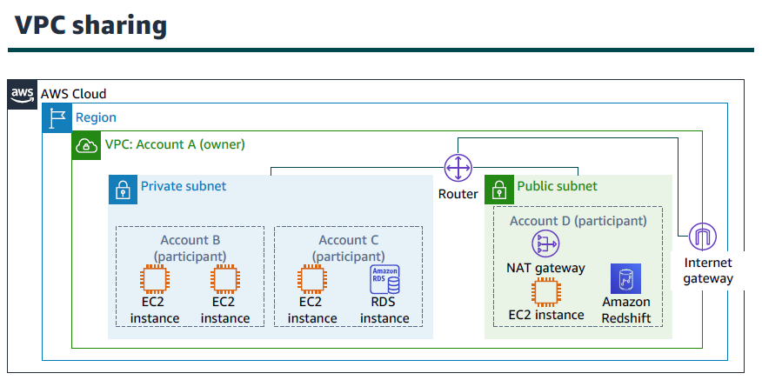

Slide 42
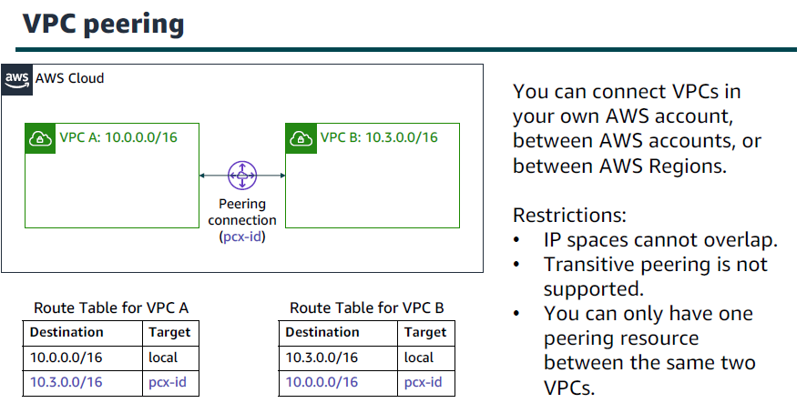

Slide 43
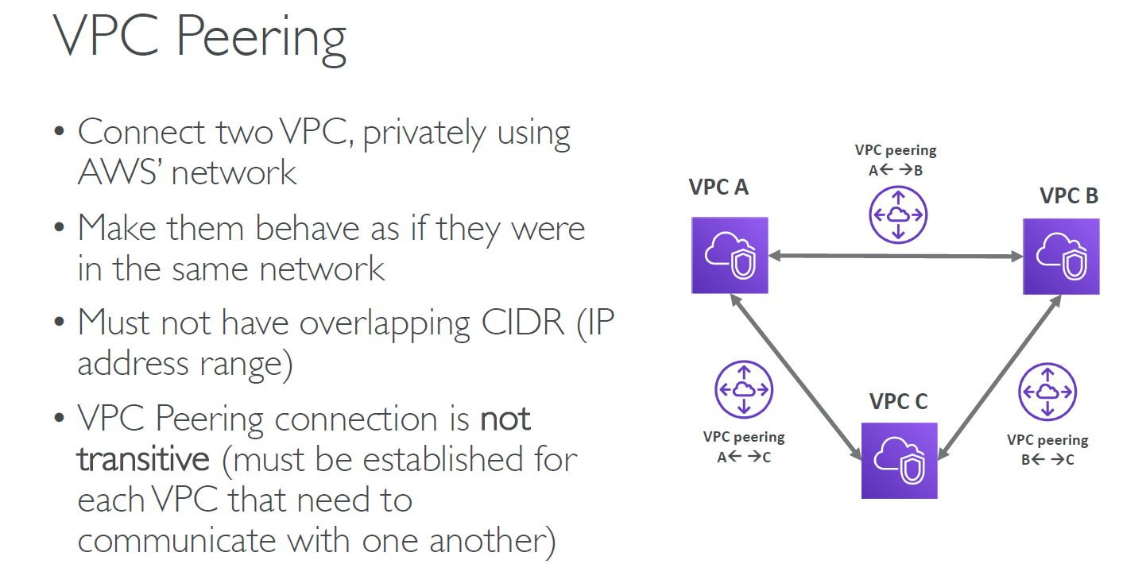

Slide 44
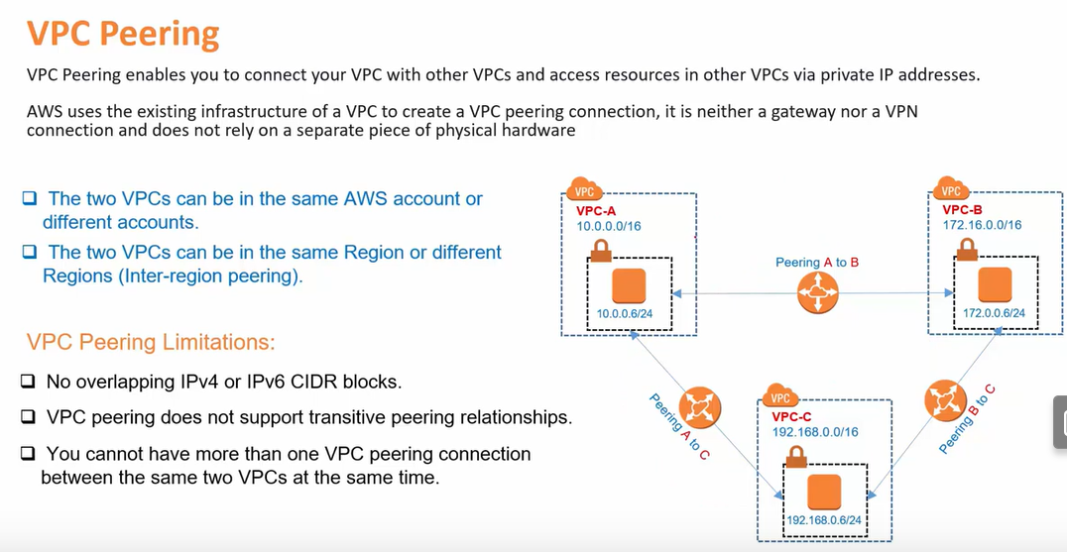

Slide 45
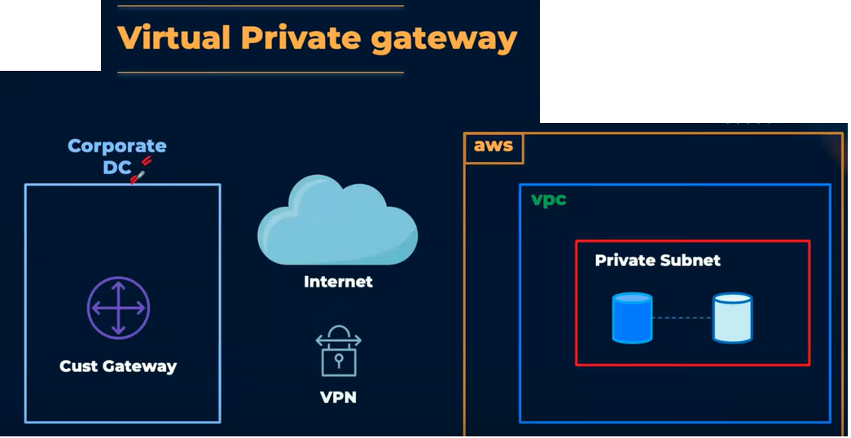

Slide 46
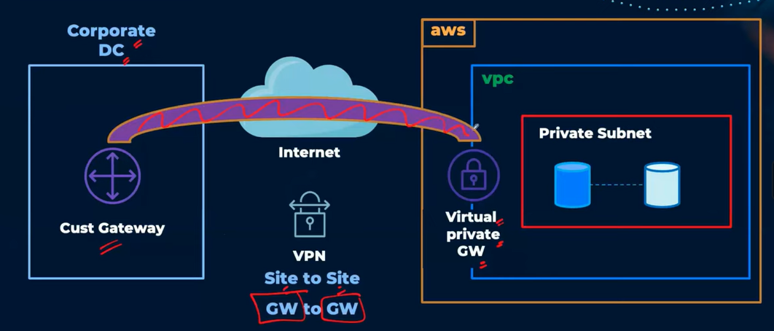

Slide 47
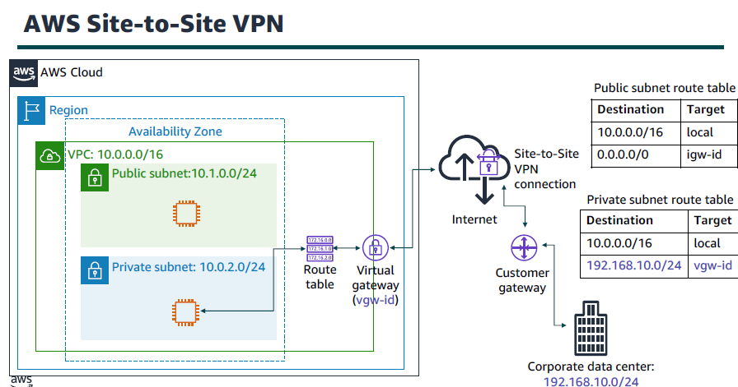

Slide 48
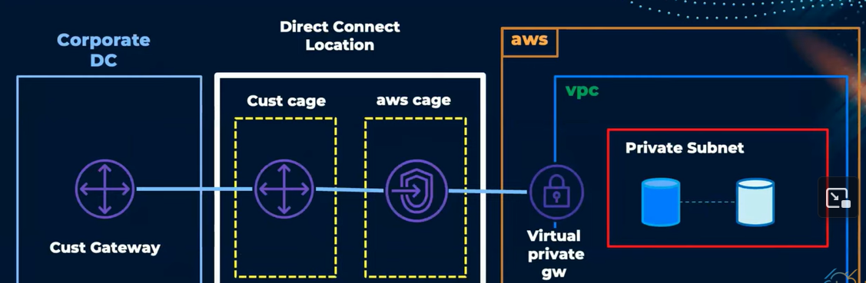

Slide 49


Slide 50


Slide 51


Slide 52


Slide 53


Slide 54


Slide 55


Slide 56


Slide 57


Slide 58



Slide 59



Slide 60


Slide 61


Slide 62


Slide 63


Slide 64


Slide 65


Slide 66


Slide 67


Slide 68


Slide 69


Slide 70


Slide 71


Slide 72


Slide 73


Slide 74



Slide 75


Slide 76

Lab scenario

Slide 77


Search for VPC service

Slide 78

Create a VPC

Slide 79

Select VPC and More

Slide 80

Define the Name Tag and the CIDR block
(min /28 and max /16)

Slide 81

Configure number of AZs, public, and private subnets

Slide 82

Configure the CIDR block for each subnet
(Cannot be overlapped)

Slide 83

Configure the NAT gateway to be in 1 AZ

Slide 84

Preview the created VPC

Slide 85

Wait for the VPC to be Created

Slide 86

The Current VPC

Slide 87

View the created VPC

Slide 88

Create a new subnet (Public Subnet)

Slide 89

Select VPC ID for our VPC (lab-vpc)

Slide 90

Configure the subnet name, choose a different AZ, and configure the CIDR block

Slide 91

Create the Subnet

Slide 92

Create another subnet (Private Subnet)

Slide 93

Configure the subnet as before and choose the CIDR block

Slide 94

Create the subnet

Slide 95

Assign a Route table for the new subnets

Slide 96

Select the Route table for private subnet 1 and assign it for private subnet 2

Slide 97

Associate a new subnet to it

Slide 98

Select the two subnets

Slide 99

Repeat for the public subnets

Slide 100


Slide 101


Slide 102

Select the two subnets

Slide 103

The current VPC

Slide 104

Create a new Security Group for a web server

Slide 105

Configure the name, Description, and VPC

Slide 106

Add a new Inbound Rule, Type: HTTP,
Source: Any IPv4

Slide 107

Create a Security Group

Slide 108

Open EC2 Service

Slide 109

Launch Instance (Web server)

Slide 110

Keep the AMI as Amazon Linux

Slide 111

Keep the instance type t2.micro

Slide 112

Select the key pair “Vockey”

Slide 113

Configure the Network Settings

Slide 114

Select the created Security group

Slide 115

Expand Advanced details section

Slide 116

Paste the instructions in “User data” field

Slide 117
Launch the instance

Slide 118

Wait until the initialization phase is complete

Slide 119

Select the web server, copy the public IPv4 DNS

Slide 120

Displaying the web page

Slide 121

The Final VPC

Slide 122
Activity: Design a VPC
Scenario: You have a small business with a website that is hosted on an Amazon Elastic Compute Cloud (Amazon EC2) instance. You have customer data that is stored on a backend database that you want to keep private. You want to use Amazon VPC to set up a VPC that meets the following requirements:
Your web server and database server must be in separate subnets.
The first address of your network must be 10.0.0.0. Each subnet must have 256 total IPv4 addresses.
Your customers must always be able to access your web server.
Your database server must be able to access the internet to make patch updates.
Your architecture must be highly available and use at least one custom firewall layer.

Slide 123

Notes:
/28

Slide 124

Notes:
/16

Slide 125

Notes:
NAT gateway

Slide 126

Notes:
Amazon VPC

Slide 127

Notes:
False

Slide 128

Notes:
AWS edge Locations

Slide 129

Notes:
Network ACL

Slide 130

Notes:
A main route is created by default

Slide 131

Notes:
Security Groups

Slide 132

Notes:
251

Slide 133
Questions
1- Your private subnets need to connect to the Internet while still remaining private. Which AWS-managed VPC component allows you to do this?
Security Groups
Internet Gateway
NAT Gateway
Network ACL
Notes:
NAT gateway

Slide 134
Questions
2- Which type of firewall has both ALLOW and DENY rules and operates at the subnet level?
Network Access Control List (NACL)
Web Application Firewall (WAF)
Security Groups
Network Address Translation (NAT)
Notes:
NACL

Slide 135
Questions
3- You need a logically isolated section of AWS, where you can launch AWS resources in a private network that you create. What should you use?
Availability Zone (AZ)
A VPC
A NAT instance
Network ACL
Notes:
VPC

Slide 136
Questions
4- Your VPC needs to connect with the Internet. Which VPC component can help?
NAT Gateway
Security Group
Internet Gateway
Network ACL
Notes:
Internet Gateway

Slide 137
Questions
5- A VPC is available in which scope:
Regional
Global
Availability Zone
Notes:
Regional

Slide 138
Questions
6- A public subnet is accessible from the Internet while a private subnet is not accessible from the Internet.
True
False
Notes:
True

Slide 139
Questions
7- A public subnet is an Availability Zone resource.
True
False

Slide 140
Questions
8- The largest IPv4 CIDR block size in a VPC is /20.
True
False
Notes:
False

Slide 141
Questions
9- Each subnet must be associated with a route table.
True
False
Notes:
True

Slide 142
Questions
10- NACL (Network ACL) is a firewall which controls traffic from and to an EC2 instance.
True
False
Notes:
False

Slide 143

Notes:
false >> limited services

Slide 144

Notes:
false

Slide 145

Notes:
false

